Slide 1
Dumbways Bootcamp Devops
Week 2
Gilbran Fairuz Maulana

Slide 2
Manage Code & Database

Slide 3
INSTALL GIT & SSH KEY
Task Week 2
01
SETUP DATABASE
02
DEPLOYMENT BACKEND APPLICATION
03
REVERSE PROXY FOR BACKEND APPLICATION
04
CUSTOM DOMAIN FOR BACKEND APPLICATION
05
Fork "https://github.com/DumbwaysDotId/housy-backend" to your GitHub account.
Create SSH Key for the Git
Git on the server can git pull, git commit, git push without username & password
Create new instance for Backend
Install database on the server
Can remote on the database from the client
Setup security group with private IP
Clone application in here https://github.com/DumbwaysDotId/housy-backend
Change directory to backend and deploy the application.
Import database with sequelize.
Update and upgrade the operating system.
Install web server for reverse proxy.
Create reverse proxy from application with port 5000 to port 80.
Setup subdomain for the application api.name.instructype.com
SSL CONFIGURATION FOR BACKEND APPLICATION
06
The applications can access from https://api.name.instructype.com

Slide 4
INSTALL GIT & SSH KEY
01

Slide 5
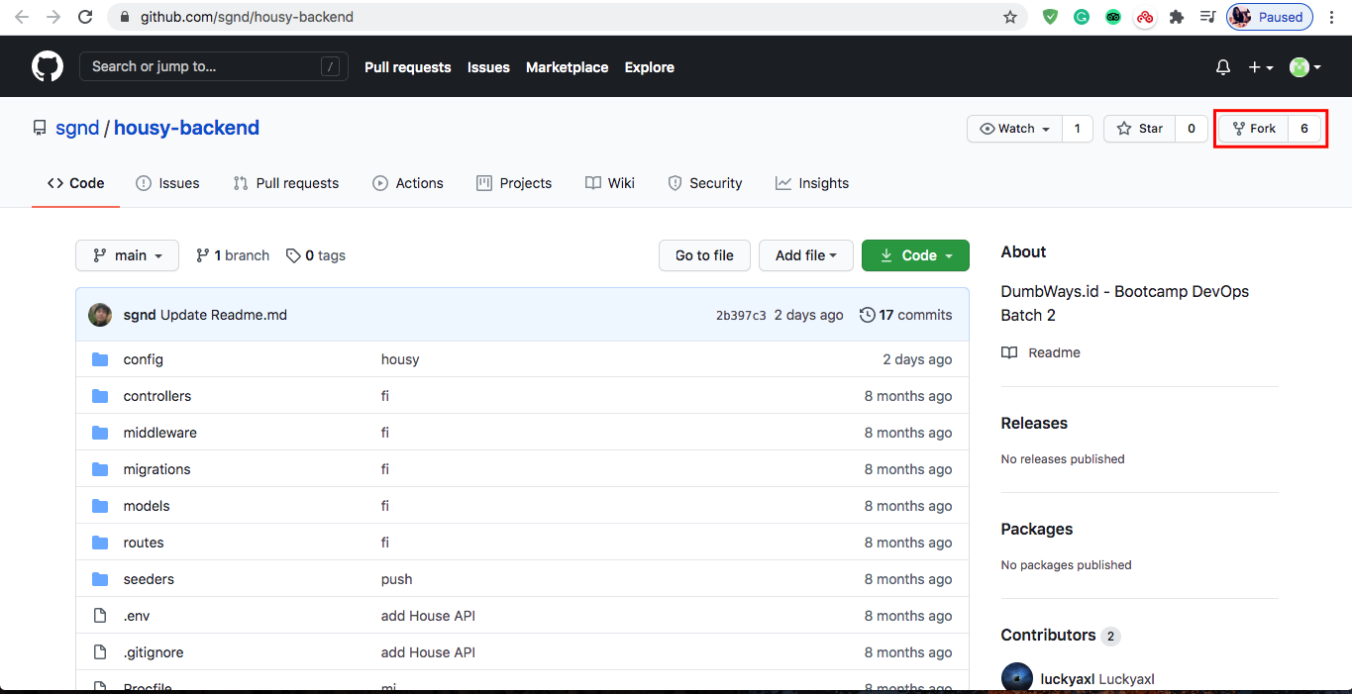
INSTALL GIT & SSH
Fork project Backend dan Frontend

Slide 6
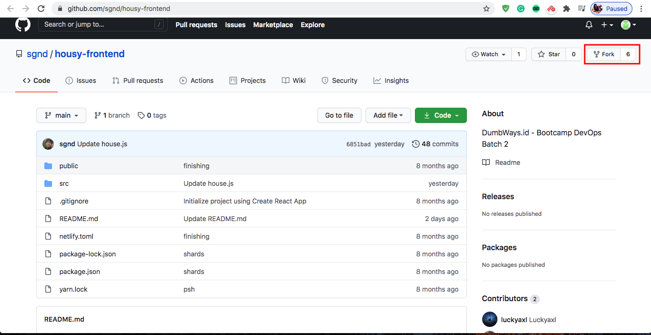
INSTALL GIT & SSH
Fork project Backend dan Frontend

Slide 7
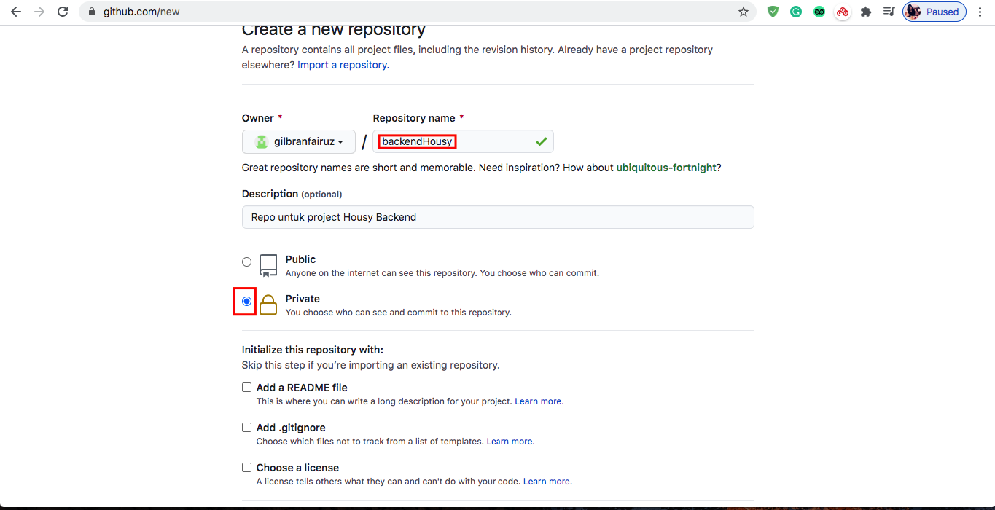
INSTALL GIT & SSH
Buat dua repository untuk project frontend dan backend

Slide 8
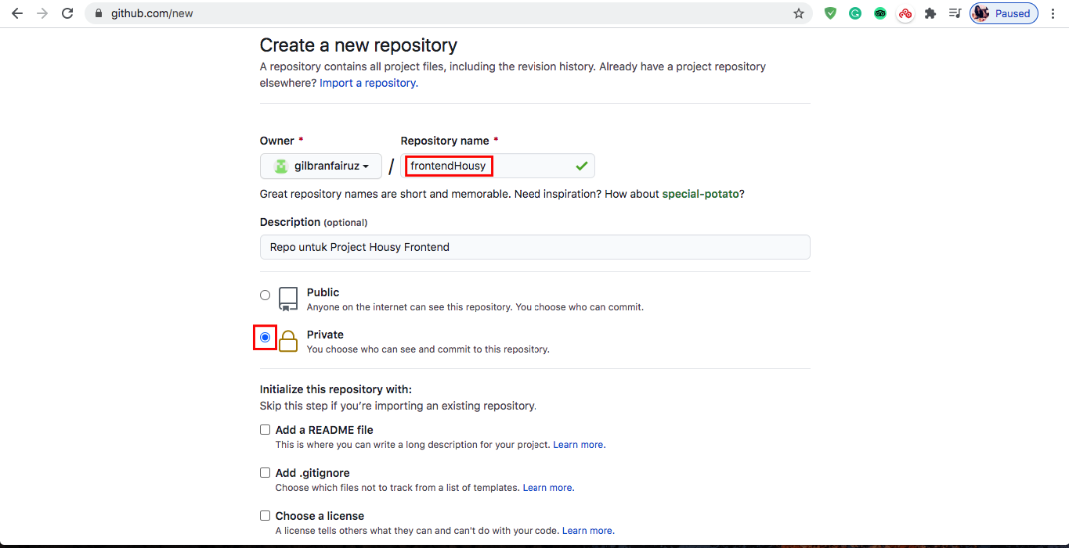
INSTALL GIT & SSH
Buat dua repository untuk project frontend dan backend

Slide 9
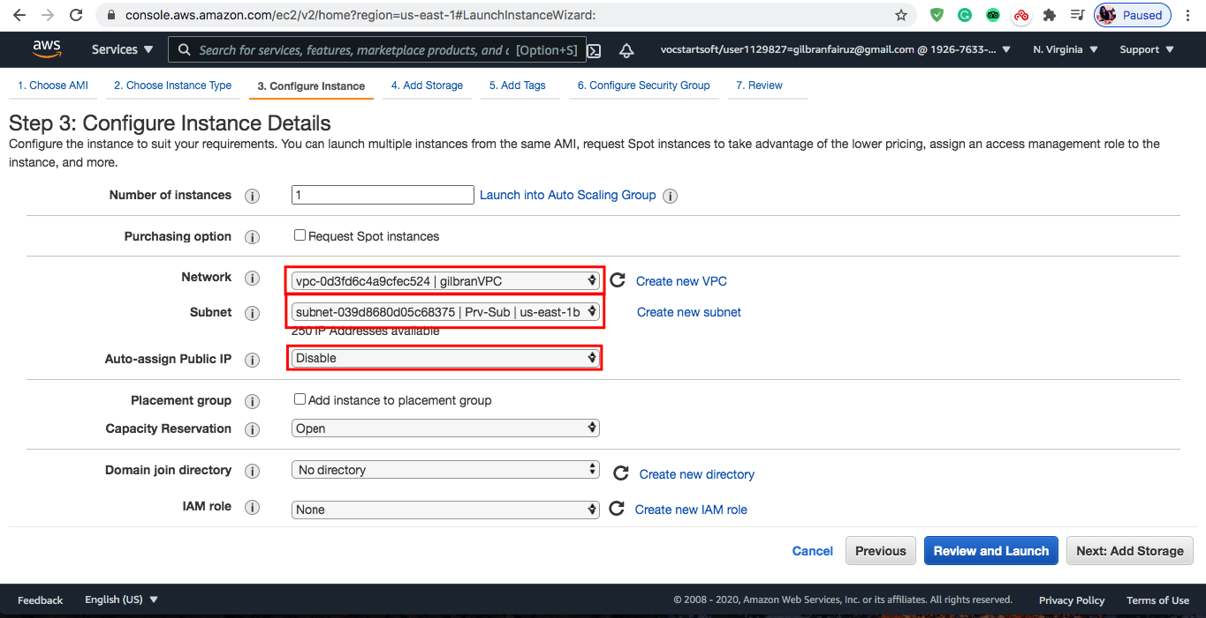
INSTALL GIT & SSH
Buat instance baru yang jumlahnya disesuaikan dengan skema task (2 Frontend, 1 Backend, 1 Database).

Slide 10
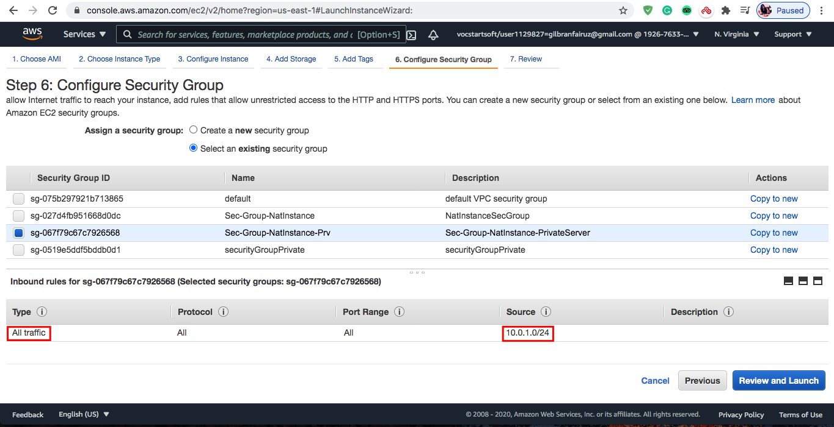
INSTALL GIT & SSH
Semua instance baru ini dibuat private.

Slide 11
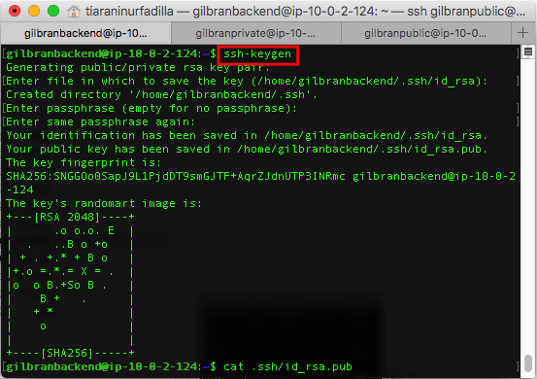
INSTALL GIT & SSH
Pada setiap instance dilakukan command "ssh-keygen”.

Slide 12
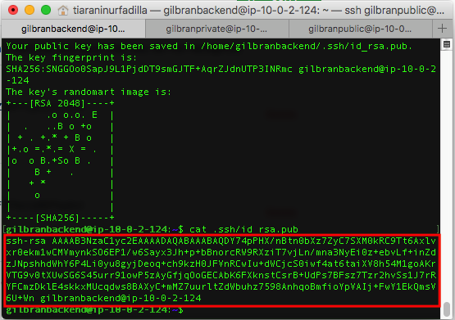
INSTALL GIT & SSH
Copy isi file keygen, untuk didaftarkan pada Github

Slide 13
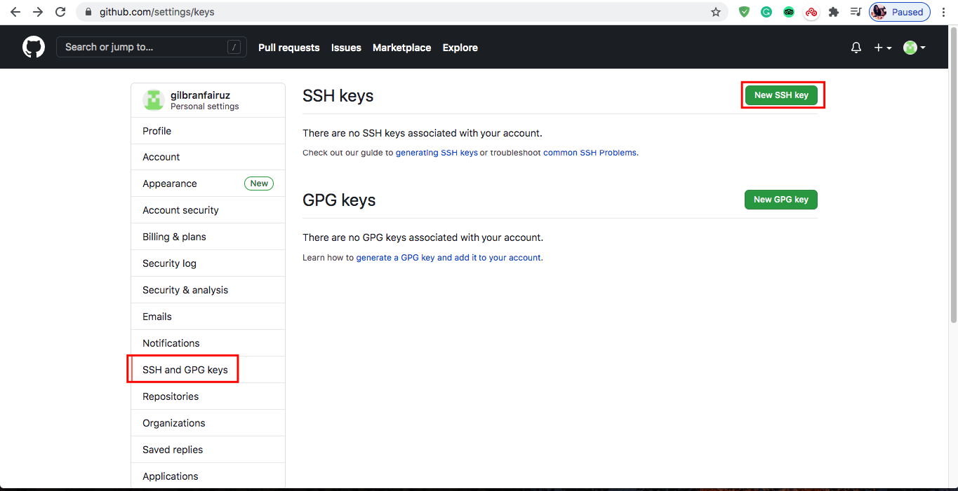
INSTALL GIT & SSH
Pada github klik setting, lalu pilih menu "SSH and GPG Keys", lalu klik "New SSH Keys" untuk menambahkan SSH key dari setiap instance.

Slide 14
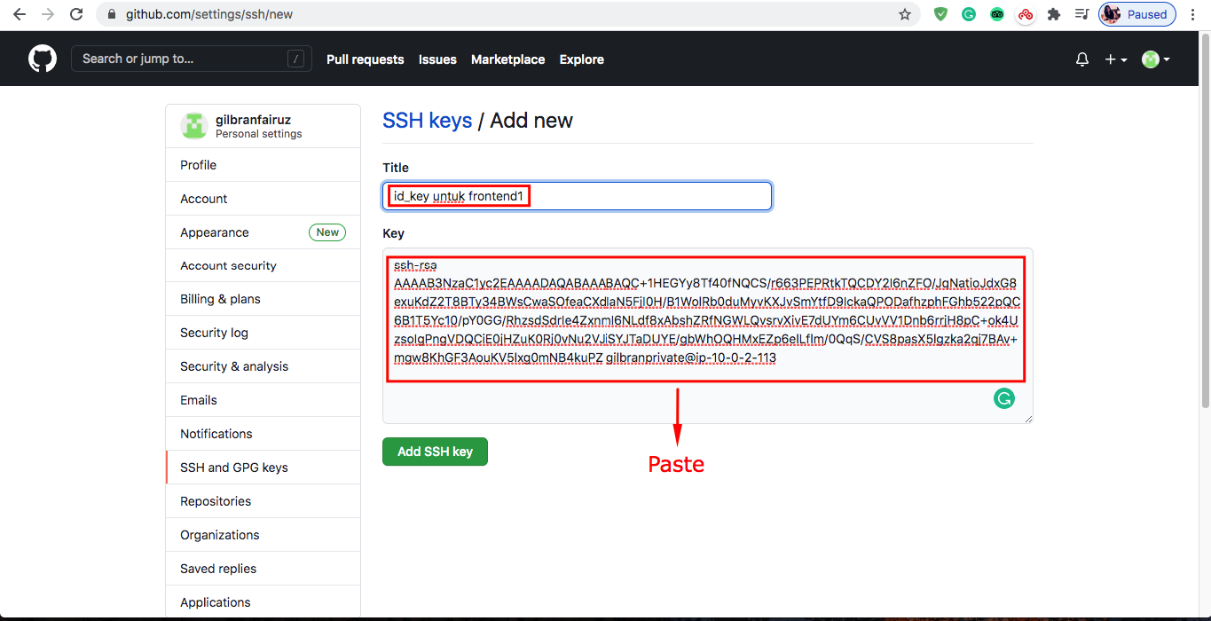
INSTALL GIT & SSH
Paste file keygen dari setiap instance

Slide 15
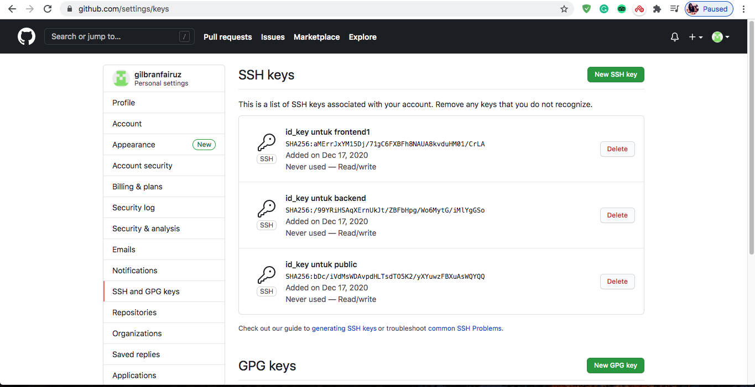
INSTALL GIT & SSH
Lalu akan muncul tampilan berikut, apabila sudah semua server dilakukan penambahan SSH key.

Slide 16
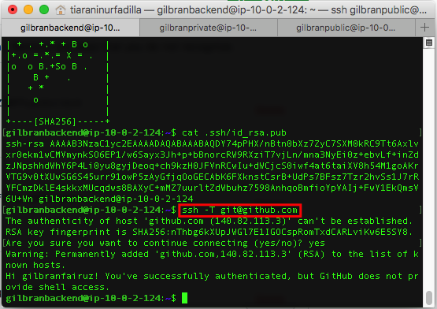
INSTALL GIT & SSH
Lalu lakukan "ssh -T git@github.com" pada semua server, untuk melakukan autentikasi.

Slide 17
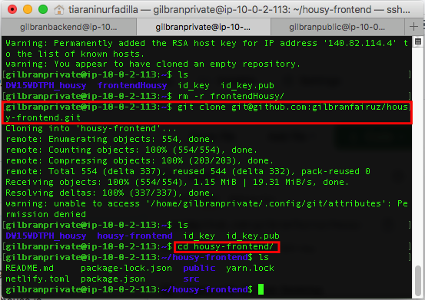
INSTALL GIT & SSH
Lakukan clone project frontend dan backend, lalu masuk direktori project.

Slide 18
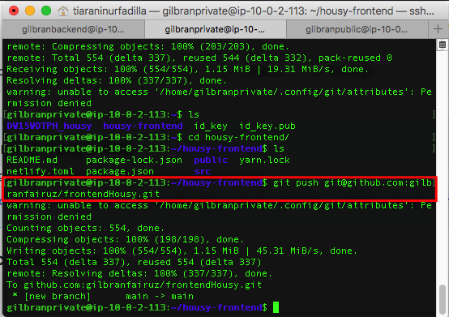
INSTALL GIT & SSH
Push project tersebut ke repository yang tadi dibuat

Slide 19
SETUP DATABASE
02

Slide 20

SETUP DATABASE
Venus has a beautiful name and is the second planet from the Sun. It’s terribly hot—even hotter than Mercury—and its atmosphere is extremely poisonous. It’s the second-brightest natural object in the night sky after the Moon

Slide 21
DEPLOYMENT BACKEND APPLICATION
03

Slide 22
INSTALL GIT & SSH
Push project tersebut ke repository yang tadi dibuat

Slide 23
REVERSE PROXY FOR BACKEND APPLICATION
04

Slide 24
SETUP DATABASE
Venus has a beautiful name and is the second planet from the Sun. It’s terribly hot—even hotter than Mercury—and its atmosphere is extremely poisonous. It’s the second-brightest natural object in the night sky after the Moon

Slide 25
CUSTOM DOMAIN FOR BACKEND APPLICATION
05

Slide 26
INSTALL GIT & SSH
Push project tersebut ke repository yang tadi dibuat

Slide 27
SSL CONFIGURATION FOR BACKEND APPLICATION
06

Slide 28
SETUP DATABASE
Venus has a beautiful name and is the second planet from the Sun. It’s terribly hot—even hotter than Mercury—and its atmosphere is extremely poisonous. It’s the second-brightest natural object in the night sky after the Moon

Slide 29
Terima Kasih

